Slide 1
6. Javadoc
Comments in Java
// Can be single line comments
/* More than one line.
Useful to "erase" a block
of code from compilation */
/**
* A Javadoc comment
* To generate nice HTML documentation
*/

Slide 2
What is Javadoc?
A standard for documenting Java programs
javadoc.exe
generates documentation of your Java classes in a standard format
comes with the JDK.
For each X.java, it will create an X.html
plus a couple of additional pages (index, ..)
ex: If you wrote MyClass.java
then running “javadoc MyClass.java”
generates a file “MyClass.html”
that contains properly formatted comments

Slide 3
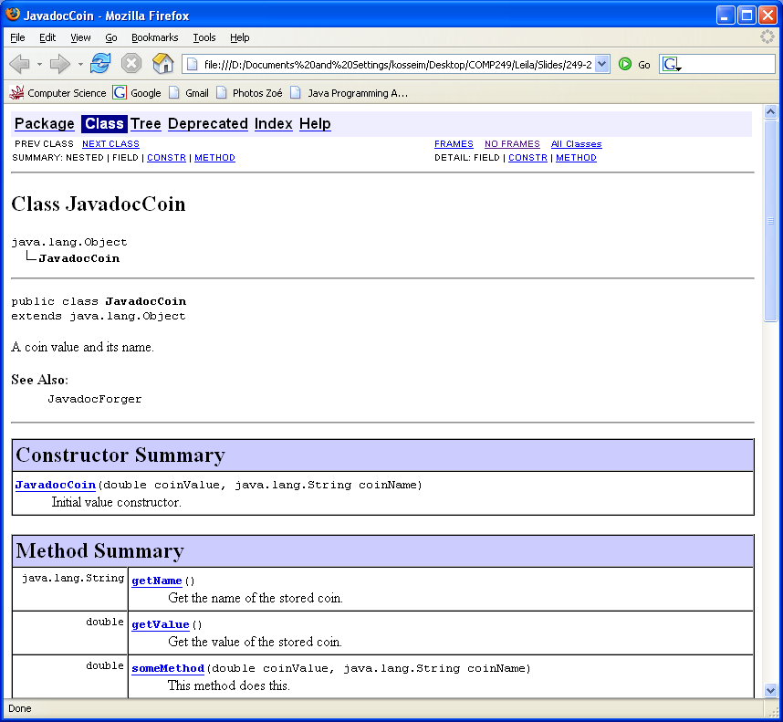

Slide 4
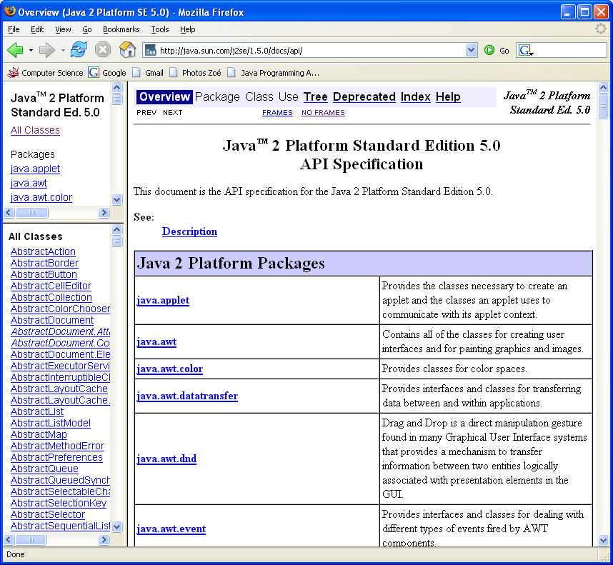
The output from Javadoc looks exactly like the API documentation… since that's the way it was generated!

Slide 5
General form of a Javadoc comment
/**
* One sentence ending with a period describing the purpose.
* Additional lines giving
* more details (html tags can be included)
*
* javadoc tags to specify more specific information,
* such as parameters and return values for a method
*
* @Tag Description ...
* @Tag Description ...
*
*/

Slide 6
Tags
Allow you to specify specific information used in the HTML file
most common tags:
For files, classes and interfaces:
@author Name
@version Version number
For methods:
@param name description
@return description
@exception exceptionClass description
@deprecated description
For everything:
@see relatedReference (ex. other class name)

Slide 7
Documenting Files, Classes and Interfaces
Javadoc comments go immediately before the class or interface (or top of file)
ex:
/**
* A coin value and its name.
* @author YourNsmr
* @version 1.1
* @see JavadocForger
*/
public class JavadocCoin {
…
}
javadoc -author -version Javadoc.java

Slide 8
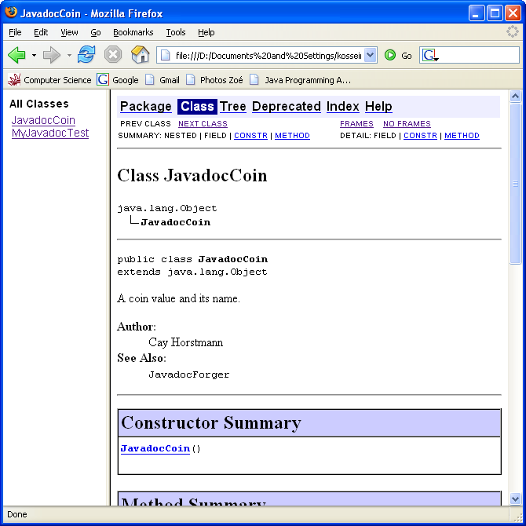

Slide 9
Documenting Methods
Javadoc comments go immediately before the method definition
Common tags :
@param <name of parameter> <description>
@return <description>
ex:
/**
* This method does this.
* @param coinValue Initial coin value
* @param coinName Initial coin name
* @return The value of the coin
*/
public double someMethod(double coinValue, String coinName){
…
}

Slide 10
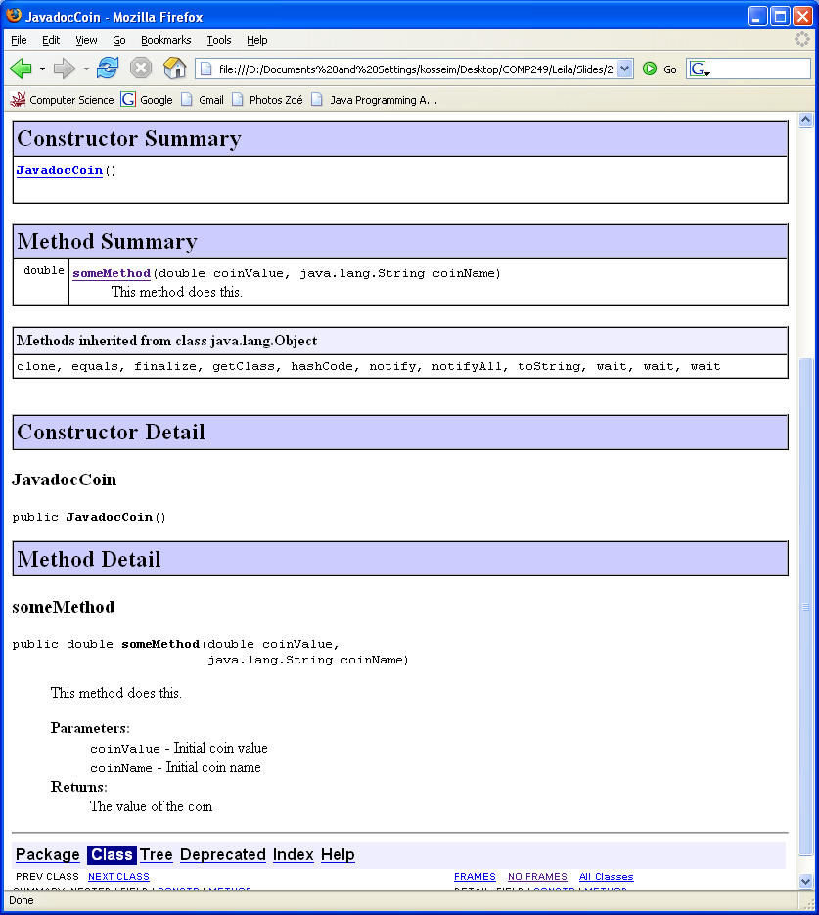

Slide 11
Javadoc
can add Html tags to the comments to add nicer formatting to the resulting document.
Advantages:
looks very nice…
provides a consistent look and feel to API documents
when source code is changed:
the Javadoc comments can be changed in the source, at the same time.
the external documentation is then easily re-generated.

